Slide 1
Week4 Presentation (after revising)
IET Xu Yinghan
yixu@tcd.ie

Slide 2
Functionality
Don’t like too complicated images. Recall a memory of completely simple-image game.
Background, Player, Interaction=>All simple
Ninja (Designed like MatchStick Men)
Jump/Attack/Difficulty level (More time: barrier/dart/speed up)

Slide 3
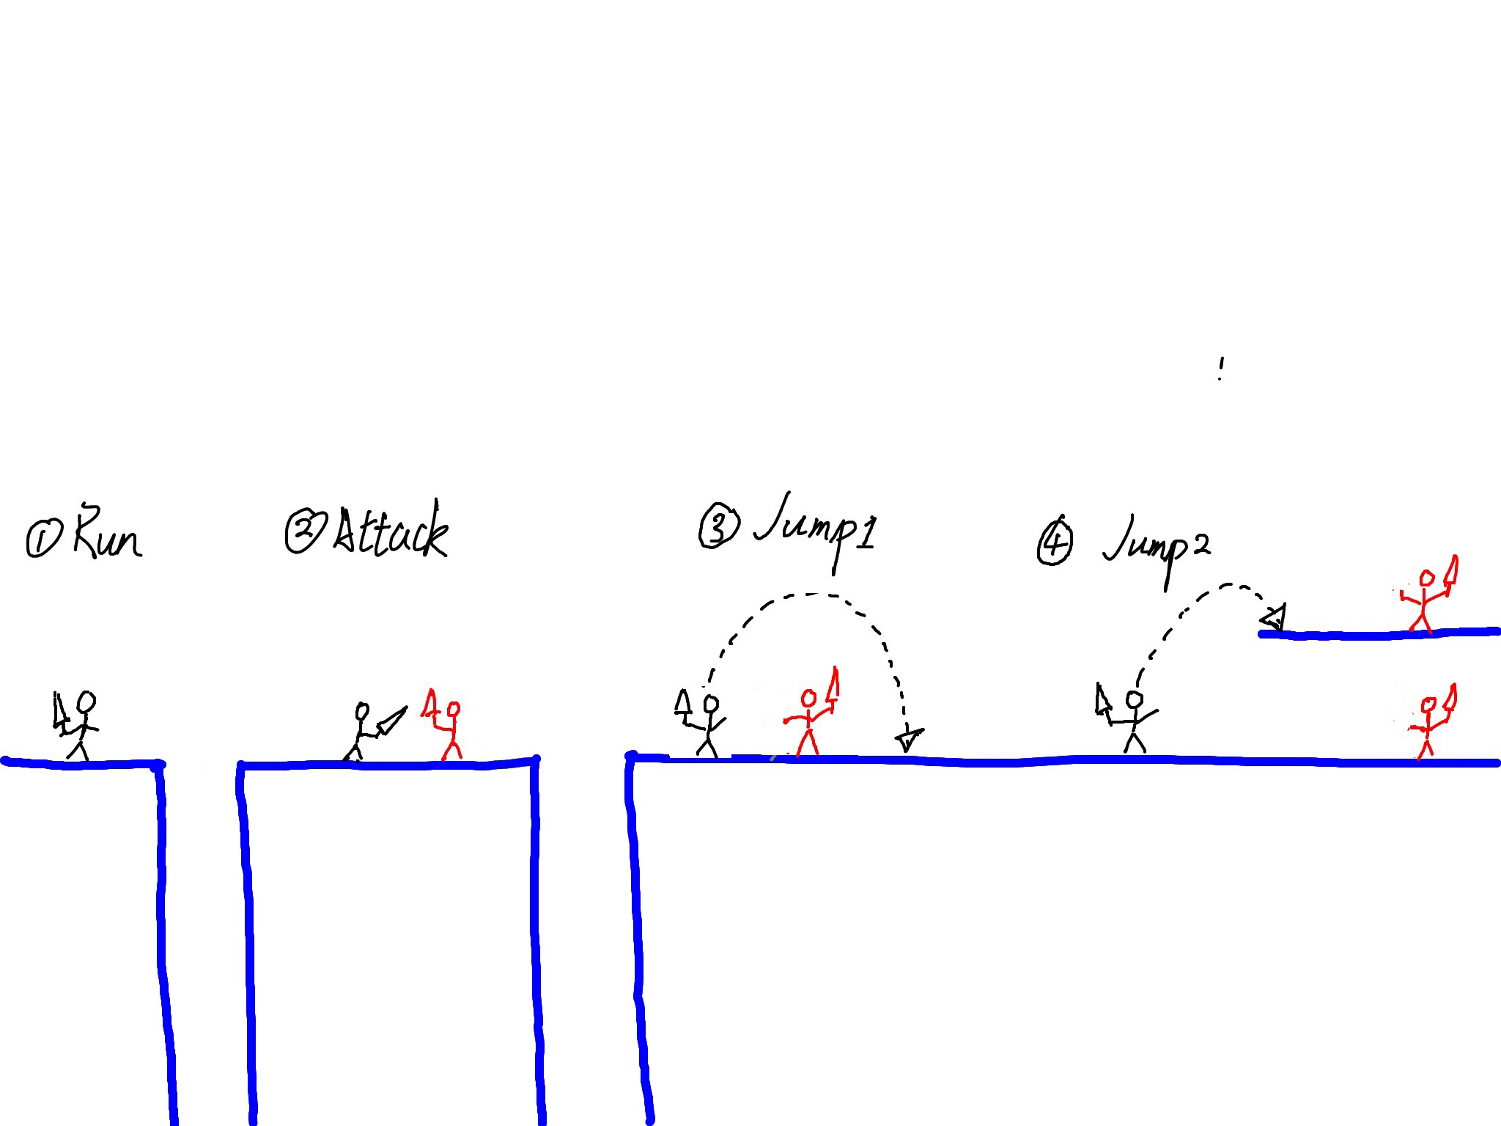
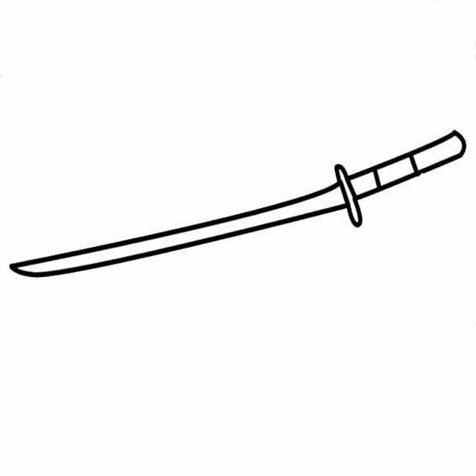
Appearance and Interaction

Slide 4
Testing
Depend on how complicated the game is. (Several module or not)
Security/Privacy/Safety
Do not need to consider in this game

Slide 5
Planning
Week1：Installed Android Developers Tools and an IDE and follow some tutorials.
Week2: Continued following tutorials for Android Game. Reviewed some Java syntax.
Week3: Tried to think about what’s kind of App is suitable for the task within the limited time.
Week4: Prepared this presentation which help me to figure out whether my project could be made on time and what’s kind of skills needed. Decided the target App and the core element (finding some similar game examples/tutorials).

Slide 6
Week5: Construct the ground. Make sure the ground could run regularly (include some cliffs). Also construct the second ground, to make sure I have complete the whole background for half of my whole time. Then I can focus on dealing with characters’ creating and their function.
Week6: Create the player, enemy and ally. Player would die if jump off.
Week7: Create the jump and waving animation for the character.
Week8: Prepare the presentation and find if I have caught up with the plan. If not, change the planning for the next few weeks because there’re not too much time left (passing 2/3 time).

Slide 7
Week9: Creating the attacking movement and dealing with the logical determination to make sure the sword waving nicely (calculate the distance of the enemy and the player)
Week10: Copy the way working in first ground to second ground. It’s not hard but still need to change some parameters in there.
Week11: Full integration of various elements, testing, fixing.
Week12: Prepare for the demonstration and the presentation.

Slide 8
What’s the difference from the first version of this presentation
After knowing how to deal with this kind of game, I find that I should deal with one kind of module in the same period of time. In the first version, I put the first ground floor and character creating task in the same week. In the past, I just want to build the whole architecture for the game (including the ground and the character). However, there’s no need to separate the ground task and character task. I should build all grounds, including first ground and second ground in one time. And creating all characters in one time, separately in two weeks. After compressing the time, I could have time to finish second floor’s work at last, which is the part I drop.

